Slide 1
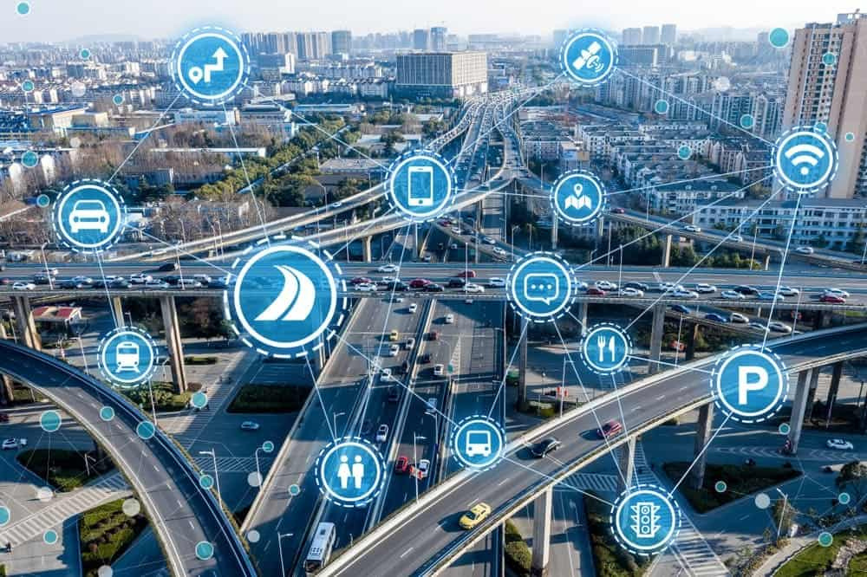

SMART TRANSPORTATION SYSTEMS
By: Rakrak Abir, Doha Sassa

Slide 2
Plan
1-Introduction
2-General steps of developing STS
3-Case study : Traffic prediction Gru
4-Results
--What is a smart transportation system
-Main benefits of STS
-Examples of urban Transportation technology
-What is GRU
-Used technologies

Slide 3


I-Introduction :
According to the US Department of Transportation, “Intelligent Transportation Systems (ITS) apply a variety of technologies to monitor, evaluate, and manage transportation systems to enhance efficiency and safety.”
smart transportation and smart city traffic management are revolutionizing how cities approach mobility and emergency response while reducing congestion on city streets. How? With sensors, advanced communication technologies, automation, and high-speed networks.
3

Slide 4

Benefits of STS
Smart Transportation is safer:
Smart Transportation is better managed:
autonomous transportation systems (both in vehicles and in stationary infrastructure such as intersections) have proven to reduce the “human factor” in accidents.
Smart transportation not only provides detailed data points for every aspect of the transportation system, but allows administrators to better monitor operations, track maintenance needs, and identify key sources of problems that need to be fixed.
4

Slide 5

Examples of urban transportation technology
Miami Dade Advanced Traffic Management System
SEPTA PTC
SMART Dispatch System
5

Slide 6
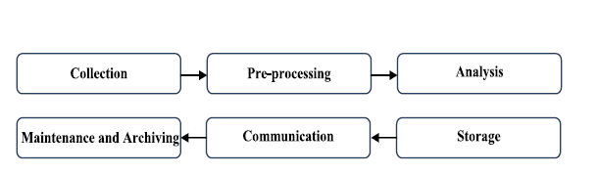
II-General steps of developing STS:
6

Slide 7
Depuis janvier 2025
Case Study :
Traffic prediction using GRU(Gated Reccurent unit)

Slide 8
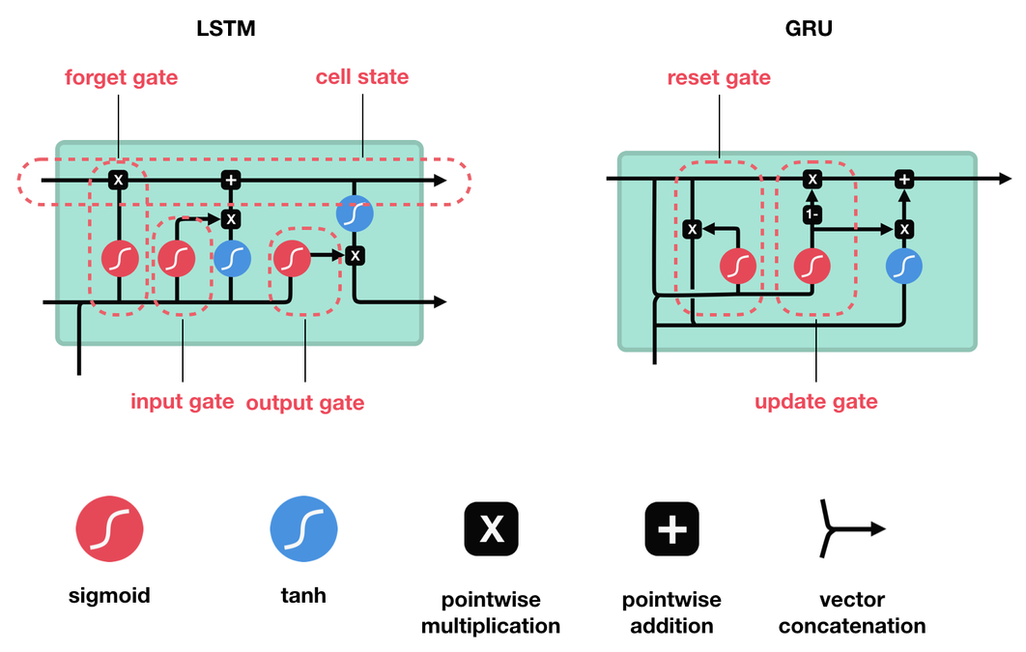
GRU(Gated Reccurent unit)
Introduced by Cho, et al. in 2014, GRU (Gated Recurrent Unit) aims to solve the vanishing gradient problem which comes with a standard recurrent neural network. GRU can also be considered as a variation on the LSTM because both are designed similarly and, in some cases, produce equally excellent results.
8

Slide 9





Used Technologies
9

Slide 10

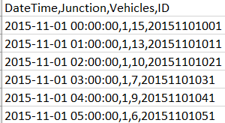
Dataset :
10

Slide 11
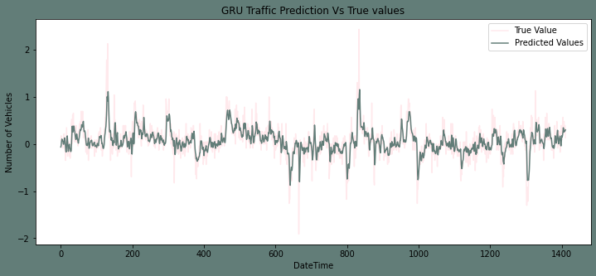
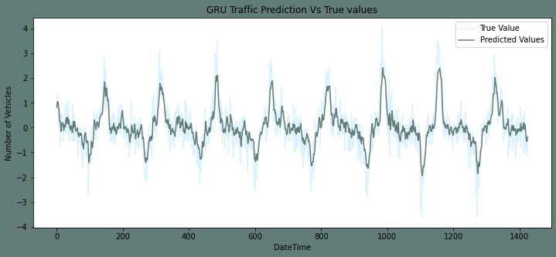
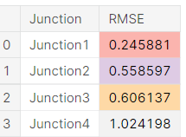
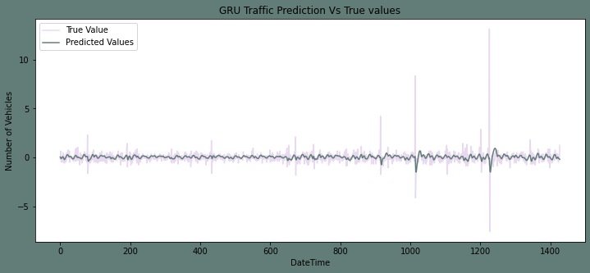
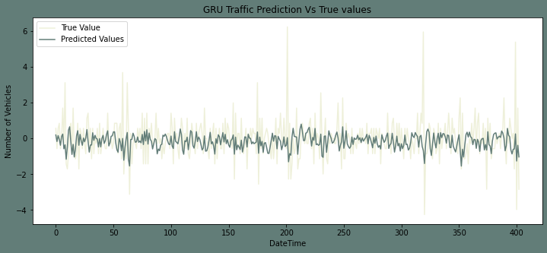
Model Results :
Junction 1 prediction vs true values
Junction 2 prediction vs true values
Root main square error
Junction 3 prediction vs true values
Junction 4 prediction vs true values
11

Slide 12
4-Results
The Number of vehicles in Junction one is rising more rapidly compaired to junction two and three. The sparsity of data in junction four bars us from making any conclusion on the same.
The Junction one's traffic has a stronger weekly seasonality as well as hourly seasonality. Where as other junctions are significantly linear.

Slide 13

CONCLUSION :

